Slide 1
Dynamic Right-Sizing for Power-Proportional Data Centers
Presented by: Group 3B
Wenlin Li
Ruiyu Qu
Jacob Zhao
Notes:
Hi everyone, we are group 3B and we are here to introduce Dynamic Right-sizing for Power-Proportional Data Centers.
I am Ruiyu, we also have Wenlin and Jacob
First, let’s take a look at why do we care about power consumption and why is energy efficiency important for data centers.

Slide 2
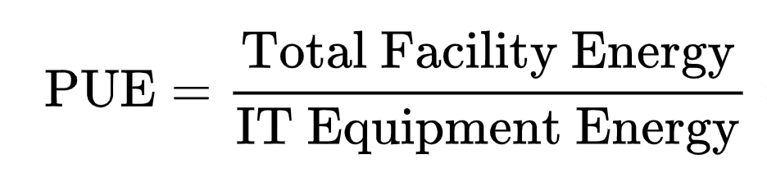
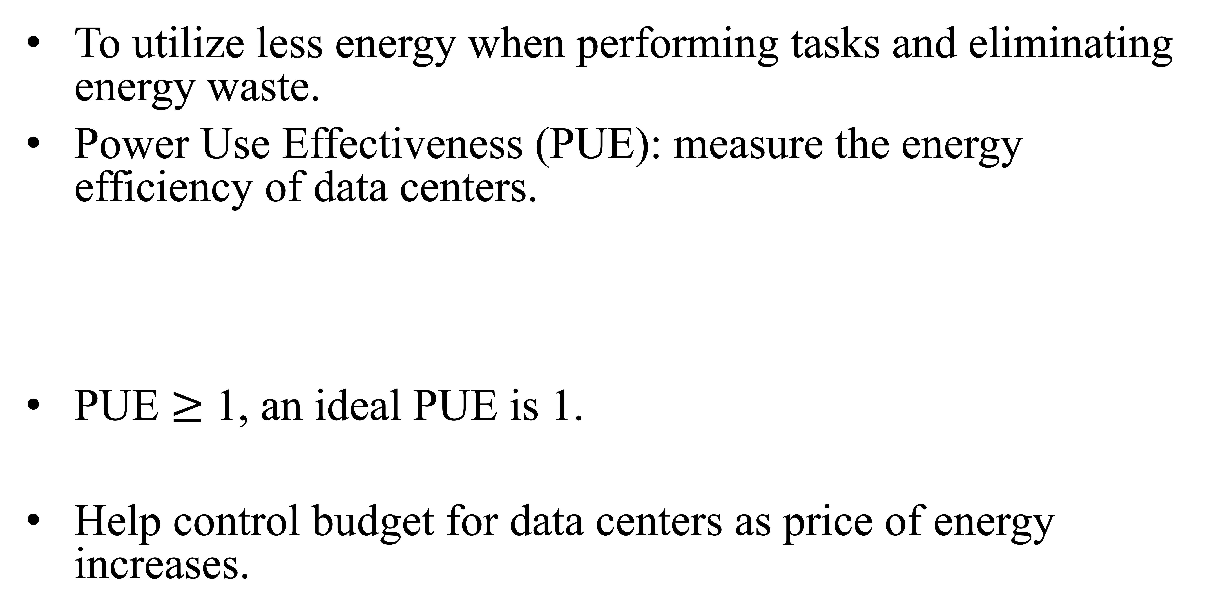
What is energy efficiency?
To utilize less energy when performing tasks and eliminating energy waste.
Power Use Effectiveness (PUE): measure the energy efficiency of data centers.
PUE $≥$ 1, an ideal PUE is 1.
Help control budget for data centers as price of energy increases.
Notes:
What is energy efficiency? It is to utilize less energy when performing tasks and eliminating energy waste. Power Use Effectiveness (PUE) is used to measure the energy efficiency of data centers.
PUE is the ratio of the amount of energy used in the center by the energy delivered to computing equipment. It is a number larger than or equal to 1, and of course, we desire to make the number as close to 1 as possible. The lower the PUE is better, because it’s saying that less energy is used for operations other than just keeping the server running.
We know that power consumption is a significant cost for data centers. So here, Improve the energy efficiency will help control budget, Since the price of energy is also increasing.

Slide 3
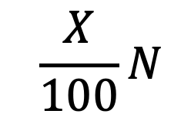
How to Improve the Energy Efficiency
Power-Proportional Data Center
Dynamically adapt the number of active servers to match the current workload.
N Watts at full load, current workload is X%
Total power consumption Watts
Ideally consume no power when in inactive power modes.
As workload increase, it would consume more power
Notes:
One way help improving the energy efficiency, is to Design data center that are power-proportional. Power-proportional data center is utilizing software techniques to dynamically adapt the number of active servers to match the current workload.
In other words, it is to make the data center Consume power in proportion to their utilization level.
For example, we say N is when computing consumes N watts at full load, and measuring the current workload by X%, then the power consumption will be X/100*N Watts.
When the server is not active, which means when there’s nearly no work is performed, it would ideally consume no power. This is very difficult to achieve. And as workload increases, it’s consumption would also increase.

Slide 4
Make data center more power-proportional
Dynamic Right-Sizing
When distributing the requests to servers during the periods of low load occur, the servers will change to a power-saving mode.
Turning off or going to sleep
Major costs
Operating cost: increasing delay when servers are in power-saving mode
Switching cost: energy used when server transition into and out of power-saving mode
Notes:
How do we make data center more power-proportional? An Existing approach is to dynamically “right-size” the data center.
Dynamic right-sizing is when distributing the requests to servers during the periods of low load occur, the low load here means when the server is not needed, or it has no jobs assigned. IT will then change to a power-saving mode by turning off or going to sleep.
Major coasts of right-sizing:
Operating cost. is Increasing delay when certain number of servers are in power-saving mode.
Switching cost indicates the energy used when server transition into and out of power-saving mode.

Slide 5
Challenges
Server needs to be able to switch without losing their state.
Determine the number of server that switched to power-saving mode
Determine the future workloads
Notes:
There are several challenges for implementing dynamic right-sizing:
First, Server needs to be able to transition into and out of power-saving mode without losing their state.
state here represents the server lift cycle.
Second, is How can we determine the number of the server that switched to power-saving mode
Last, is how can we determine the future workloads? Because we might soon need to wake up the server if we need assistant with future requests.

Slide 6
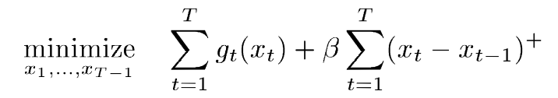
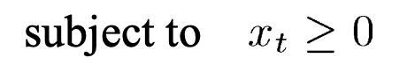
General Model
To explore cost savings possible from dynamic right-sizing
(x)⁺ = max(0,x)
t∈{0,1,…,T}is the time interval of interest.
x_{t} : capacity at time t
g_{t}() : operating cost for time-slot t. Includes arrival rate, the electricity price, the capacity on available servers, etc.
β : switching cost. We only care about this parameter if the server wakes up.
Notes:
Next, lets look at the general model,
Here is the general mode used in the paper to explore the cost savings possible from dynamic right-sizing.
First summation we see here represents the operating cost, and the second half represents the switching cost.
Where (x)⁺ is a set of non-negative variables, and it is bounded by 0 and x
t∈{0,1,…,T} represents the set of time interval of interest.
x_{t} Is the capacity at time t, it also denotes the number of active servers at time t
g_{t}() is the operating cost for time slot t. Operating cost includes many other factors, such as arrival rate, the electricity price, the capacity on available servers, etc.
β is the switching cost, which as I mentioned before, it happens when transitioning a server from the sleep state to the active state and back to sleep state again. We only care about this parameter if the server wakes up.
Not only operating cost has many factors, β here also has many factors.

Slide 7
Factors of Switching Cost
The energy used
Delay in network/data migration
With only 1. and 2., β will either approximately be the cost to run a server for a few seconds (suspend-to-RAM, network or storage state),
or the cost of running several minutes (migrate large VM)
Increased wear-and-tear costs
β Will approximately be the cost to run a server for an hour.
Risk with server switching
β Will approximately be the cost to run a server for hours.
Notes:
1)Energy used when server is in transition 2)The delay in network/data migration
An example of network migration happens when the instance we currently connected is brought down for maintenance purpose.
And examples of data migration, is moving data from one location to another, or changing the format of data from one to another.
If only take first two into consideration,
the β will either approximately be the cost to run a server for a few seconds, example here will be waking the server from suspend-to-RAM state or migrating network or storage states.
Or the cost of running could take up to several minutes, if we are to migrate a large virtual machine (VM)
3)Increased wear-and-tear costs on the server
When #3 is included, then β will approximately be the cost to run a server for an hour.
4)Risk with server switching: like I said in the previous slide, we only care about switching cost if servers are waking up, but there exists a risk that the server might not turn on properly.
If 4) is also taking in consideration, then the β could be the cost of running the server for hours.

Slide 8
Competitive Ratio
The competitive ratio of an algorithm $𝒜$ is defined as the maximum, taken over all possible inputs, of
$$\frac{cost\left(𝒜\right)}{cost\left(\text{OPT}\right)}$$ where cost(A) is the objective function under algorithm $𝒜$ and OPT is the optimal offline algorithm.
Notes:
Before talking about online algorithm, we need to point out, in this paper, competitive ratio is used to evaluate the performance of an online algorithm. As the professor talked before, competitive ratio of an algorithm A is the worst-case ratio of the cost of using algorithm A to the cost of using optimal algorithm based on perfect future knowledge.

Slide 9
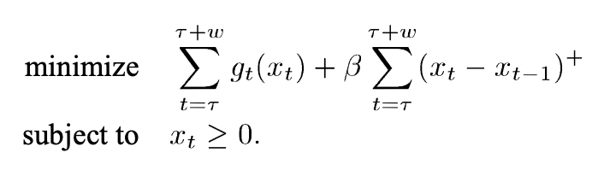
Receding Horizon Control (RHC) algorithms
Define $X^{τ}\left(x_{τ−1};g_{τ}…g_{τ+ω}\right)$ as the vector in $ℝ^{ω+1}$ indexed by $t∈\left\{τ,…,τ+ω\right\}$, which is the solution to
For all $t≤0$, set the number of active servers to $x_{t}=0$. At each time-slot $τ≥1$, set the number of active servers to
$$x_{τ}=X_{τ}^{τ}\left(x_{τ−1};g_{τ}…g_{τ+ω}\right)$$
Notes:
First, let‘s consider the standard online algorithm to the cost optimization problem. It is called Receding Horizon Control (RHC) algorithms
given the starting state x_(τ-1), RHC solves the cost optimization over the window (τ, τ+ω) at time τ. Here ω is the prediction window size
Define X^τ be the solution to the objective function, it is a vector of the number of active servers indexed by t from (τ, τ+ω)
Then, RHC works as follows. For all negative time, set the number of active servers to 0; at each timeslot τ greater than 1, set the number of active servers to xτ.
Objective function need not have a unique solution. RHC will select the solution with the greatest first entry.

Slide 10
Performance of RHC
Theorem 1: RHC($ω$) is for $\left(1+\left(β/\left(ω+1\right)e_{0}\right)\right)$ -competitive for problem(1), but not better than $\left(\left(1/ω+2\right)+\left(β/\left(ω+2\right)e_{0}\right)\right)$-competitive.
RHC performs quite well with enough lookahead.
RHC may have a poor competitive ratio for a data center with big switching cost or small prediction window.
A better online algorithm?
Notes:
Now, let’s talk about the performance of RHC for our data-center problem, and see why we need a better online algorithm.
Theorem 1 shows the competitive ratio of RHC depends on three parameters, $β$, $e_{0}$, and $ω$.
$e_{0}$ is the minimum cost per time-slot for an active server, $β$ is switching cost, $ω$ is prediction window size.
These parameters vary widely in different data centers since they host different services or have different SLAs(service level agreements ). Thus, it may have a poor competitive ratio for a data center with big switching cost or small prediction window.
We may wonder if there is a better online algorithm for this problem that performs well for a wider range of parameters, even when the prediction window w=0 (no workload prediction except current time-slot).

Slide 11
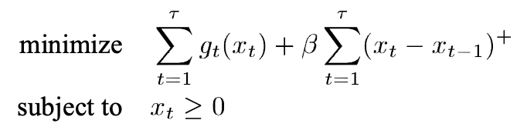
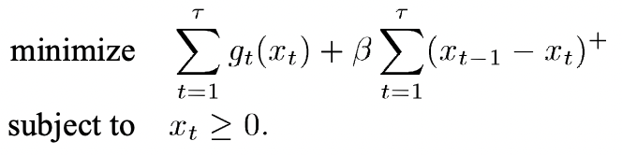
Optimal Offline Solution
Define the lower bounds $x_{τ}^{L}$ and upper bounds $x_{τ}^{U}$ of $x_{τ}^{∗}$
Let $\left(x_{τ,1}^{L},…,x_{τ,τ}^{L}\right)$be the solution vector to
Where $x_{0}=0$. Then define ${x_{τ}^{L}=x}_{τ,τ}^{L}$.
Let $\left(x_{τ,1}^{U},…,x_{τ,τ}^{U}\right)$be the solution vector to
Then define ${x_{τ}^{U}=x}_{τ,τ}^{U}$.
Notes:
In order to exploit the structure of the online solution, the first task is to characterize the optimal offline solution, the optimal solution is obtained given cost function for all timeslot.
The insight provided by the characterization of the optimal offline algorithm motivates the formulation of online algorithm.
There is a simple characterization of the optimal offline solution that two bounds correspond to switching cost either when a server comes out of power-saving mode or when it transfers to power-saving mode. $x_{τ}^{∗}$ is the optimal number of active servers at time $τ$, it can be viewed as “lazily” staying within these bounds going backwards in time.
We define the lower bound xL and upper bound xU, they correspond to x at time $τ$ of the vector solution to two objective functions.
For the lower bound, switching cost is incurred for each server comes out of power-saving mode, for the upper bound, switching cost is incurred for each server toggled into power-saving mode.
Notice that in each case, the optimization problem includes only times $1≤t≤τ$, it ignores the future information for $t>τ$.

Slide 12
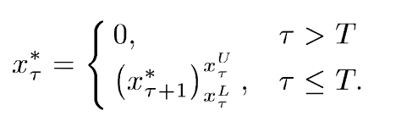
Optimal Offline Solution
Lemma 1: For all $τ$, ${x_{τ}^{L}≤x}_{τ}^{∗}≤x_{τ}^{U}$.
Theorem 2: The optimal solution $X^{∗}=\left(x_{1}^{∗},…,x_{T}^{∗}\right)$ of the data-center optimization problem (1) satisfies the backward recurrence relation
Define ${\left(x\right)}_{a}^{b}=max\left(min\left(x,b\right),a\right)⁡$as the projection of $x$ into $\left[a,b\right]$.
Notes:
Lemma 1 shows the characterization of the optimal offline solution, it lies between the lower bound and upper bound.
Then, we have theorem 2.
Theorem 2 shows that the optimal algorithm can be interpreted as moving backwards in time, starting with 0 at time T ${(x}_{T}^{∗}=0$) and keeping $x_{τ}^{∗}=x_{τ+1}^{∗}$unless the bounds prohibit this.

Slide 13

Lazy Capacity Provisioning, LCP$(ω)$
Use knowledge about the loads in the prediction window$\left(ω\right)$
Define refined bounds $x_{τ}^{U,ω}=x_{τ+ω,τ}^{U}$ and $x_{τ}^{L,ω}=x_{τ+ω,τ}^{L}$.
$ω=0$is allowed and $x_{τ}^{U,0}=x_{τ}^{U}$ and $x_{τ}^{L,0}=x_{τ}^{L}$.
Lemma 2: ${x_{τ}^{L}{≤x}_{τ}^{L,ω}≤x}_{τ}^{∗}≤x_{τ}^{U,ω}≤x_{τ}^{U}$, for all $ω≥0$.
Notes:
Now we talk about the online algorithm proposed in this paper, Lazy Capacity Provisioning, LCP
The design of LCP is motivated by the structure of the optimal offline solution.
LCP uses future information in a prediction size of $ω.$ That is to say, at time $τ$, LCP know cost function g for $t≤τ+ω$
Like the optimal solution, we define the upper bound and lower bound of LCP $x_{τ}^{U,ω}$ and $x_{τ}^{L,ω}$, note that $ω$is allowed to be 0. It means no information except current timeslot.
The lemma 2 shows optimal x “lazily” stays within upper and lower bounds.

Slide 14
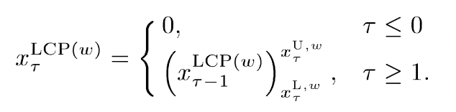
Lazy Capacity Provisioning, LCP$(ω)$
Let $X^{LCP(ω)}=\left(x_{0}^{LCP(ω)},…,x_{T}^{LCP(ω)}\right)$ donates active servers under $LPC\left(ω\right)$. It can be calculated using the following forward recurrence relation:
Theorem 3: $cost\left(X^{LCP(ω)}\right)≤cost\left(X^{∗}\right)+2{cost}_{s}\left(X^{∗}\right)$
$⟹$LPC($ω$) is 3-competitive
Notes:
Now, let’s see how LCP works with $x_{τ}^{U,ω}$ and $x_{τ}^{L,ω}$ we defined before.
T$he optimal x$ at time 0 is 0, keep $x_{τ}^{∗}=x_{τ−1}^{∗}$unless the bounds prohibit this.
We know like the optimal solution, the solution of LCP “lazily” stays within upper and lower bounds. However, it does this moving forward in time instead of backwards in time.
The theorem 3 shows LCP is 3-competitive. The competitive ratio is independent of the prediction window size and the switching cost and is uniformly bounded regardless of the form of the cost functions g
This means that even the prediction window size is 0, LCP(0) is 3-competitive, though 3-competitive may seem like a large gap, the gap will tend to be much smaller in practice, because the switching costs make up a small fraction of the total costs.

Slide 15
Case Studies
Two goals:
First, evaluate the cost incurred by LCP($ω$) relative to the optimal solution and RHC($ω$) for realistic workloads;
Second, illustrate the cost savings and energy savings that come from dynamic right-sizing in data centers
Notes:
Finally I will introduce you case studies of this paper. In this section the goal is twofold. The first is to evaluate the cost incurred by LCP(w) relative to the optimal solution and RHC(w) for realistic workloads. The second is more generally to illustrate the cost savings and energy savings that come from dynamic right-sizing in data centers. To accomplish these goals, we experiment using two real-world traces.

Slide 16
Experiment Setup
Cost Benchmark: we consider the cost incurred by a “static” right-sizing scheme for capacity provisioning. This chooses a constant number of servers that minimizes the costs incurred based on full knowledge of the entire workload
Cost Function Parameters: $d_{0, }$ $d_{1, }$ $p_{t, }$ $e_{0, }$ $e_{1, }$ $μ and β.$
Notes:
The first is experiment setup. For cost benchmark, Current data centers typically do not use dynamic right-sizing, so we consider the cost incurred by a “static” right-sizing scheme for capacity provisioning. This chooses a constant number of servers that minimizes the costs incurred based on full knowledge of the entire workload.
As for cost function parameters, We normalize u = 1, pt = 1, and choose units such that the fixed power is e0 = 1. the load-dependent power is set to e1 = 0. we set d1/e0 = 1. The normalized switching cost beta/e0 measures the duration a server must be powered down to outweigh the switching cost. In this paper we use beta = 6e0.

Slide 17
Experiment Setup
Workload Information:
The workloads for these experiments are drawn from I/O traces of two real-world data centers: Hotmail and six RAID volumes at MSR Cambridge. These activity traces represent respectively a service used by millions of users and a small service used by hundreds of users.
Notes:
Hotmail: We used traces from eight such servers over a 48-h period
RAID volumes at MSR Cambridge: The traced period was 1 week.
The traced period was 1 week

Slide 18
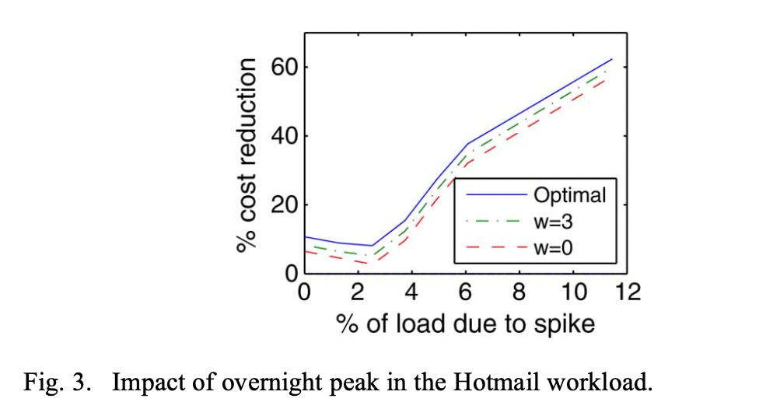
Experiment Setup
Hotmail: The Hotmail trace contains significant nightly activity due to maintenance processes (backup, index creation, etc.).
Notes:
This illustrates the impact of this decision. To provide conservative estimates of the savings from right-sizing, we chose to trim the size of the spike to minimize the savings from right-sizing

Slide 19
When is the sizing beneficial?
The experiments are organized in order to illustrate the im- pact of a wide variety of parameters on the cost savings provided by dynamic right-sizing with LCP($ω$). The goal is to better understand when dynamic right-sizing can provide large enough cost savings to warrant the extra implementation complexity.
Previous analytic results show that RHC($ω$) is more sensitive to prediction window $ω$ and switching cost $β/e_{0}$, while LCP($ω$) works well for general settings.

Slide 20
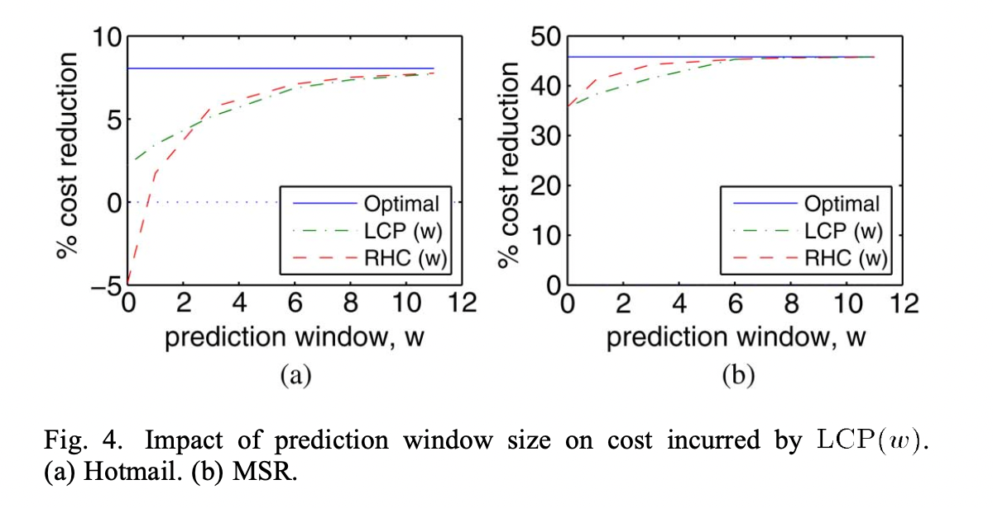
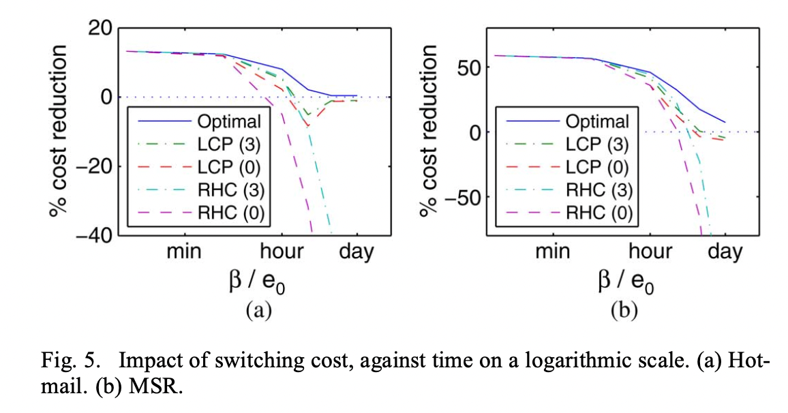
When is the sizing beneficial?
Impact of Prediction Window Size (Fig 4):
The savings possible (“Optimal”) in the MSR trace are larger than in the Hotmail trace. The cost saving of LCP($ω$) is similar to RHC($ω)$ when $ω$ is greater than 3.
Impact of Switching Costs (Fig 5) :
One observation is that significant gains are possible provided is smaller than the duration of the valleys. Another key observation is that the cost saving of LCP($ω$) is similar to that of RHC($ω$) when $β$ is small or moderate.

Slide 21
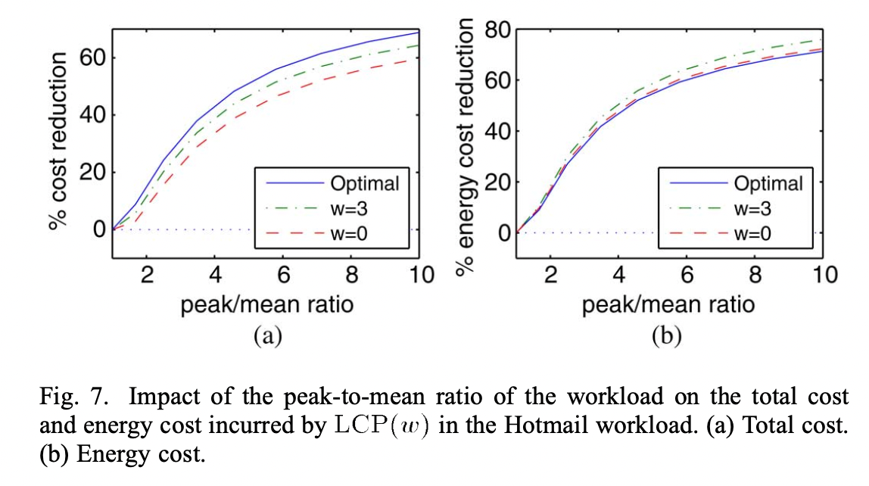
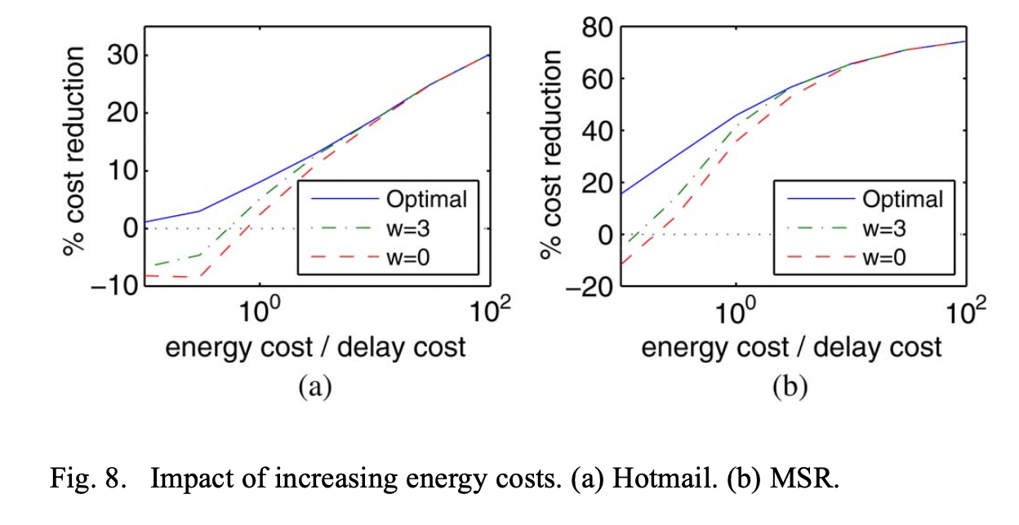
When is the sizing beneficial?
Impact of PMR:
The results in Fig. 7 illustrate that the intuition holds for both cost savings and energy savings. The gain grows quickly from zero at , to 5%–10% at PMR approaches to 2, which is common in large data centers, to very large values for the higher PMRs common in small to medium-sized data centers.
Impact of Energy Costs:
Note that the cost savings from dynamic right-sizing grow quickly as energy costs rise. However, even when energy costs are quite small relative to delay costs, we see improvement in the case of the MSR workload due to its large PMR.

Slide 22
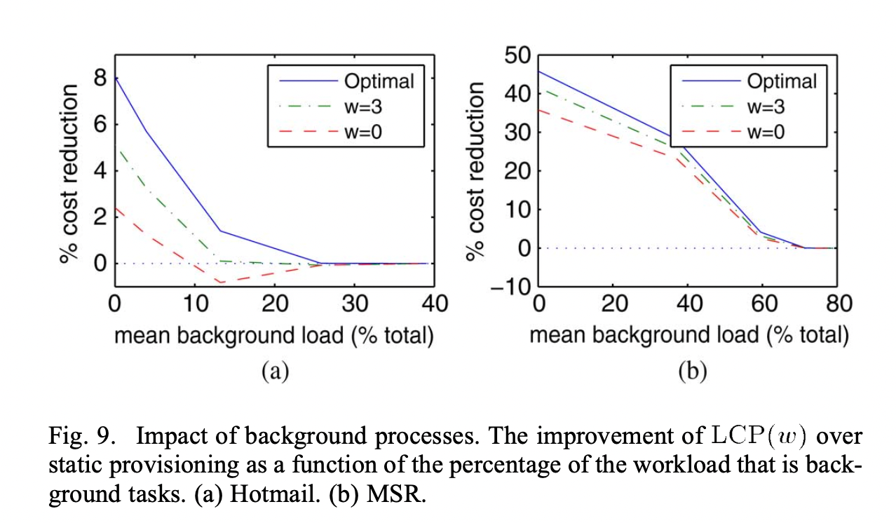
When is the sizing beneficial?
Impact of Valley Filling:
A common alternative to dynamic right-sizing that is often suggested is to run very delay-insensitive maintenance/background processes during the periods of low load, known as “valley filling.” Fig. 9 shows that, in fact, dynamic right-sizing provides cost savings even when background work makes up a significant fraction of the total load.

Slide 23
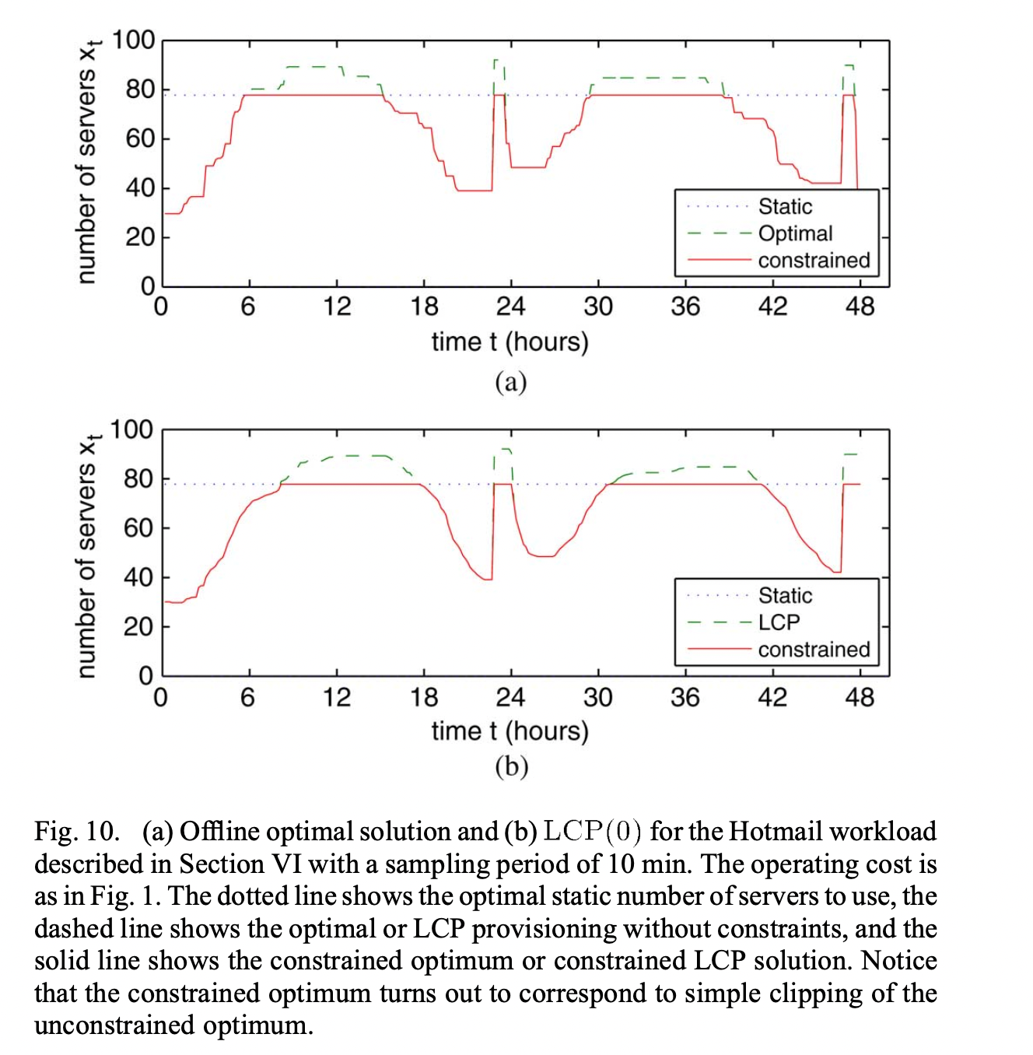
When is the sizing beneficial?
Impact of Capacity Limits:
The dotted line of Fig. 10 shows the optimal static number of servers to use, which we call , while the dashed line in Fig. 10(a) shows the optimal number and that in Fig. 10(b) shows the number used by LCP. Dynamic provisioning uses a higher peak number of servers, which would increase the cost.

Slide 24
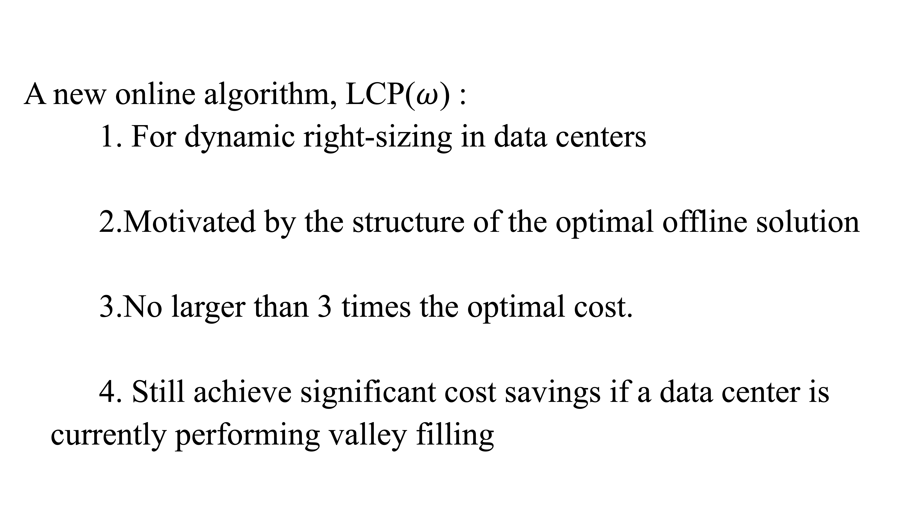
Summary
A new online algorithm, LCP($ω$) :
1. For dynamic right-sizing in data centers
2.Motivated by the structure of the optimal offline solution
3.No larger than 3 times the optimal cost.
4. Still achieve significant cost savings if a data center is currently performing valley filling
Notes:
This paper has provided a new online algorithm, LCP($ω$) , for dynamic right-sizing in data centers. The algorithm is motivated by the structure of the optimal offline solution and guarantees cost no larger than 3 times the optimal cost.
Additionally, the case studies used to evaluate LCP($ω$) highlight that the cost and energy savings achievable by dynamic right-sizing are significant, and even if a data center is currently performing valley filling, it can still achieve significant cost savings by dynamic right-sizing

